Slide 1
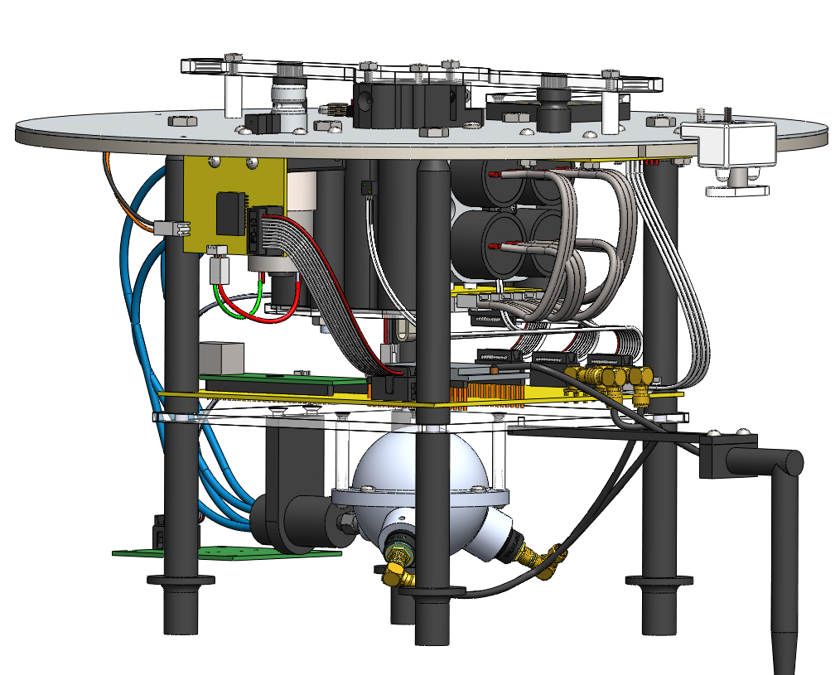
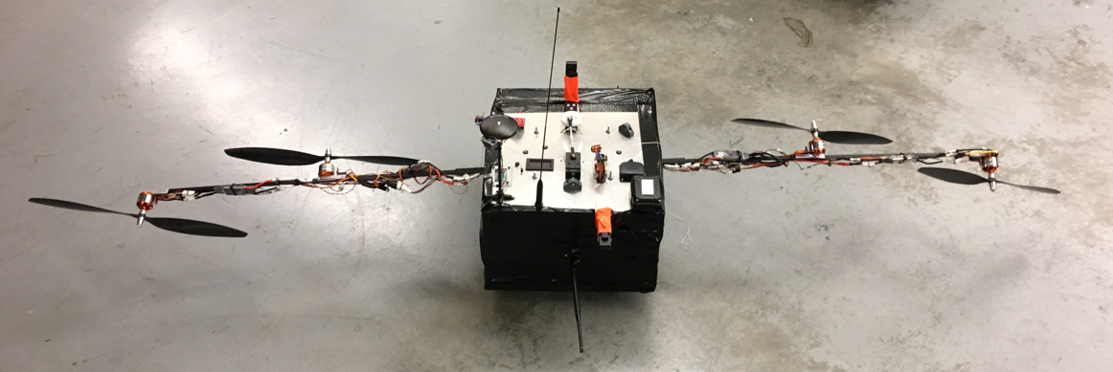
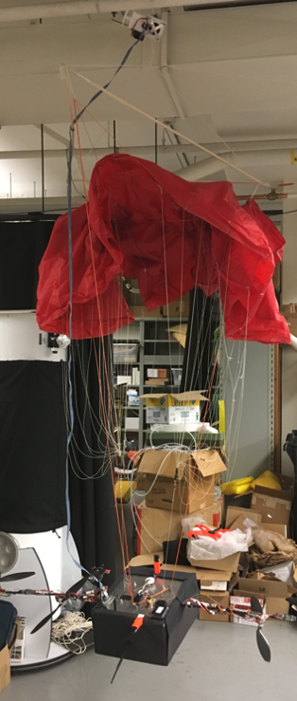
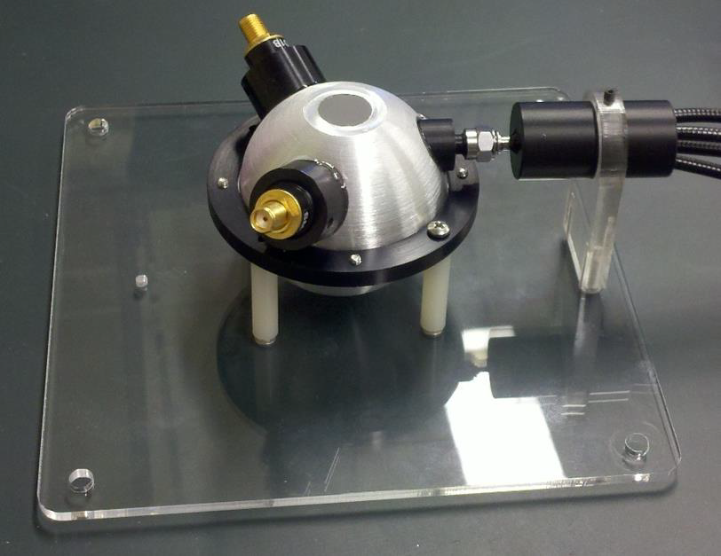
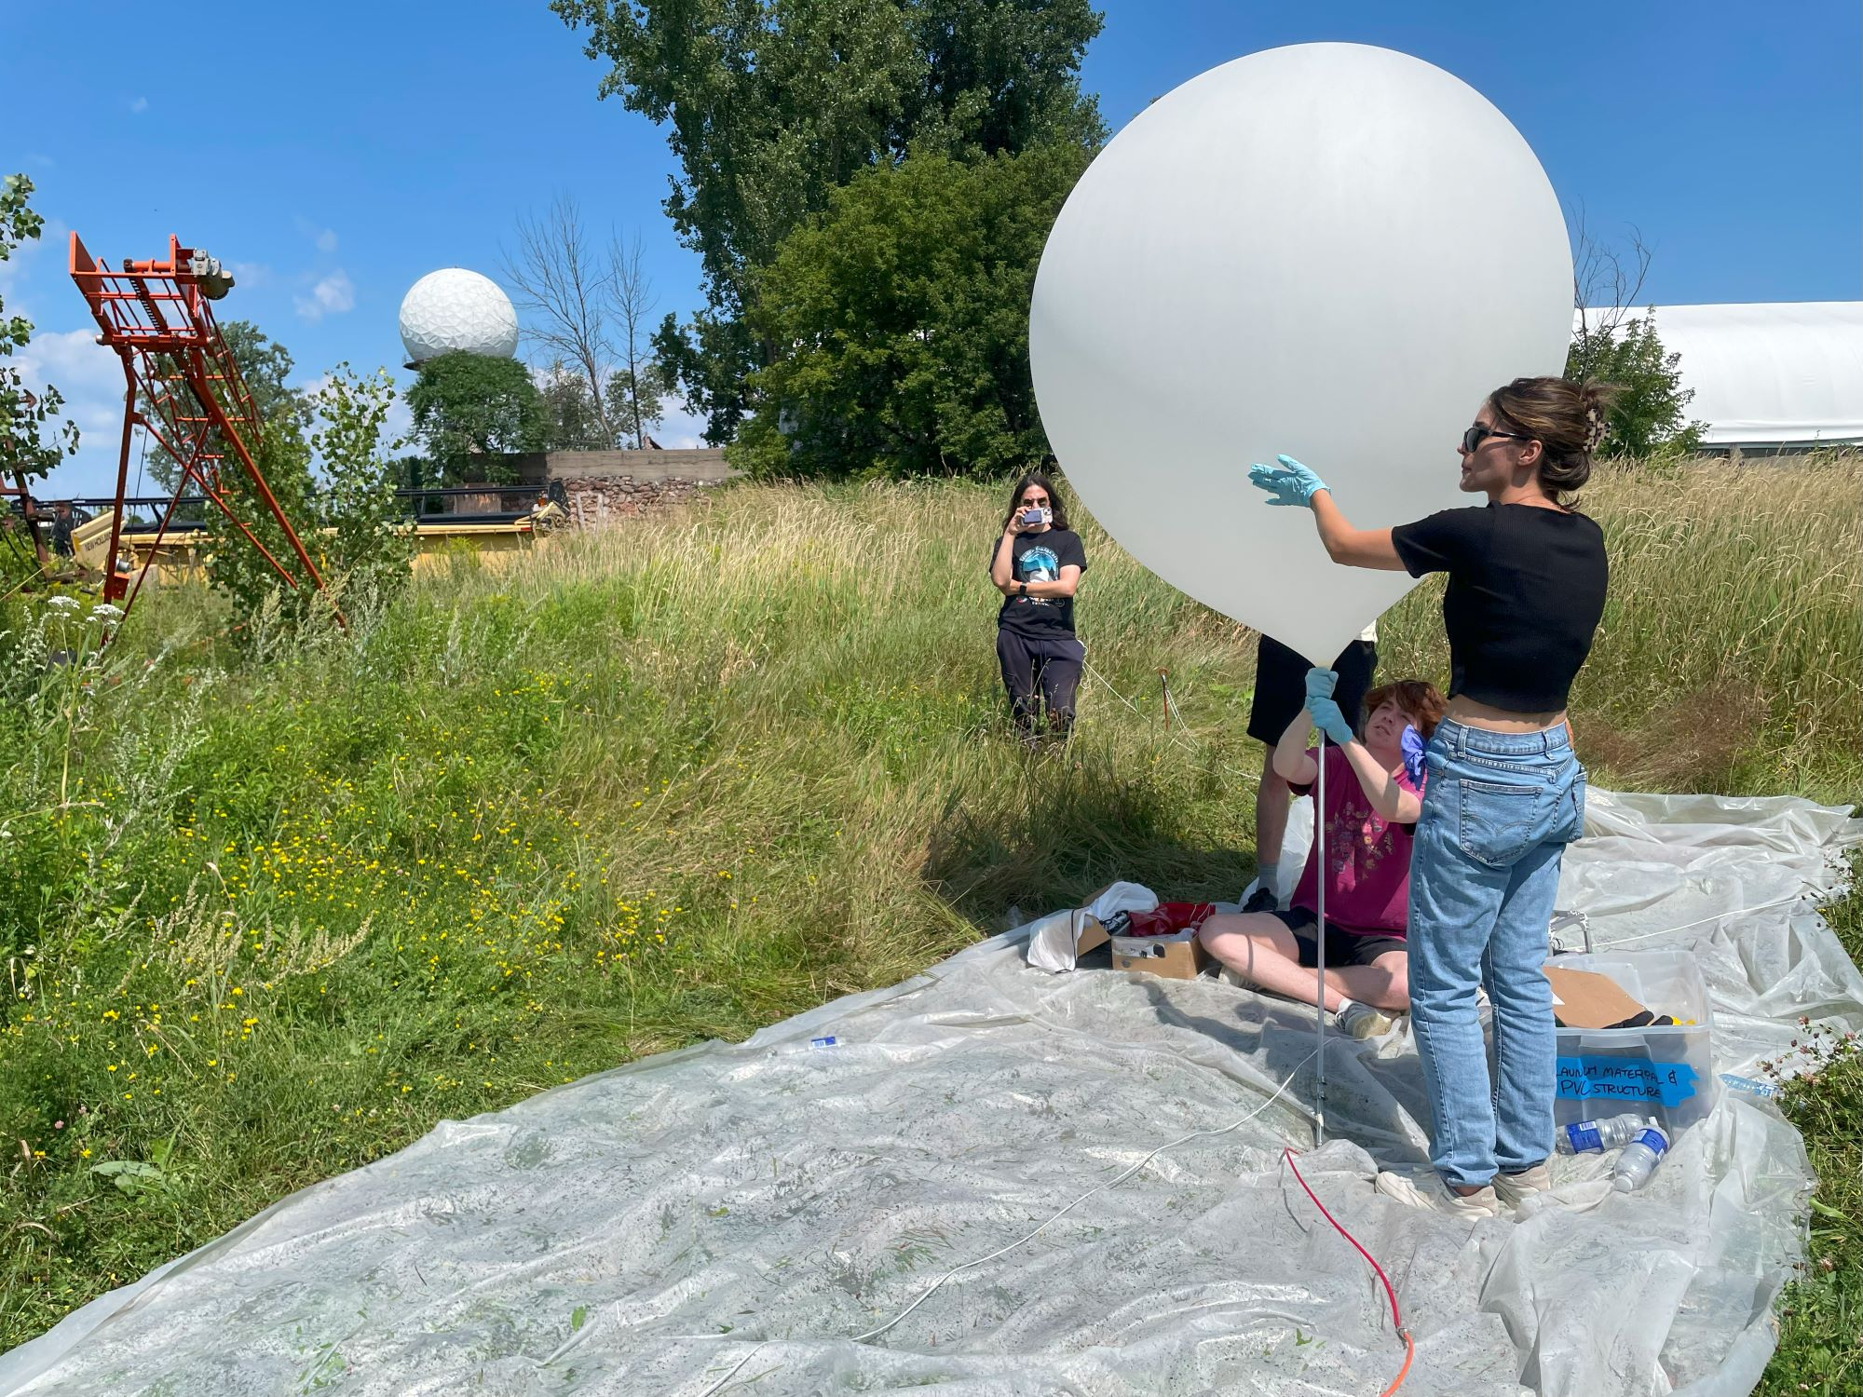
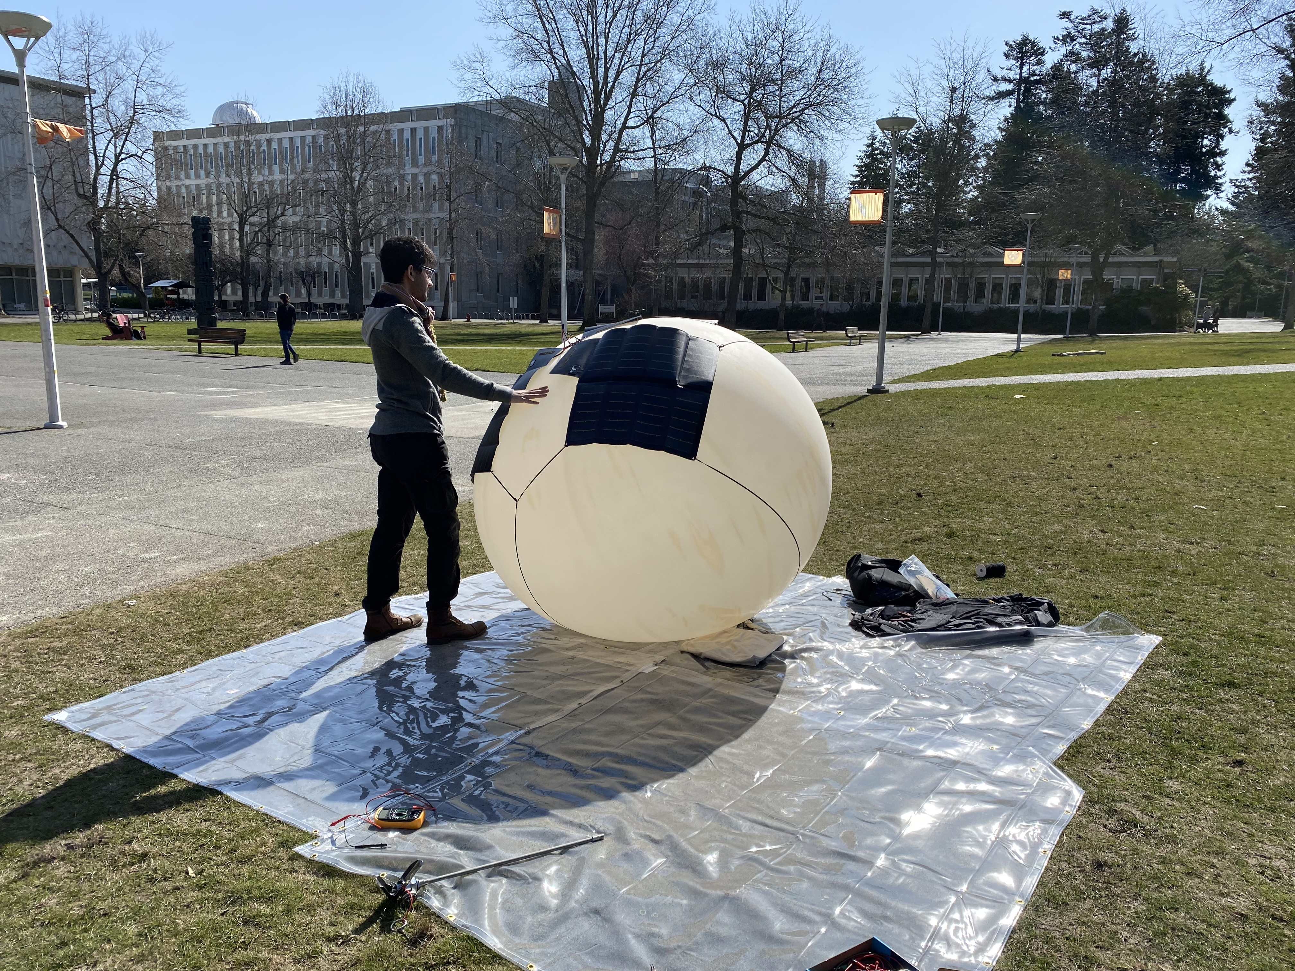
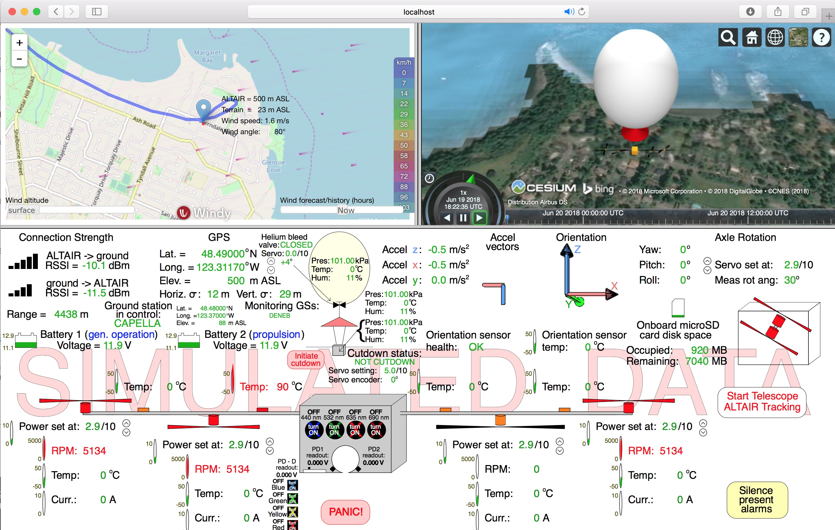
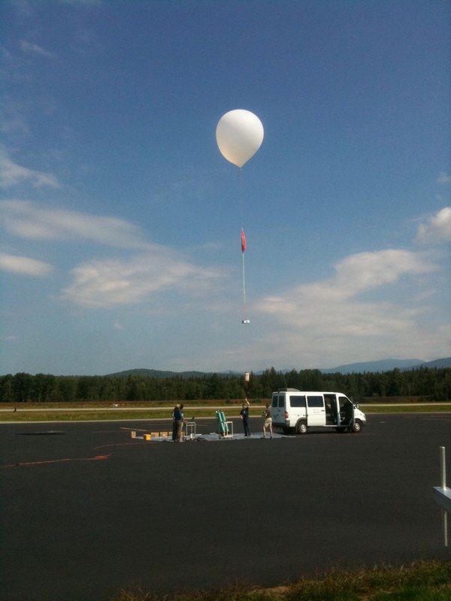
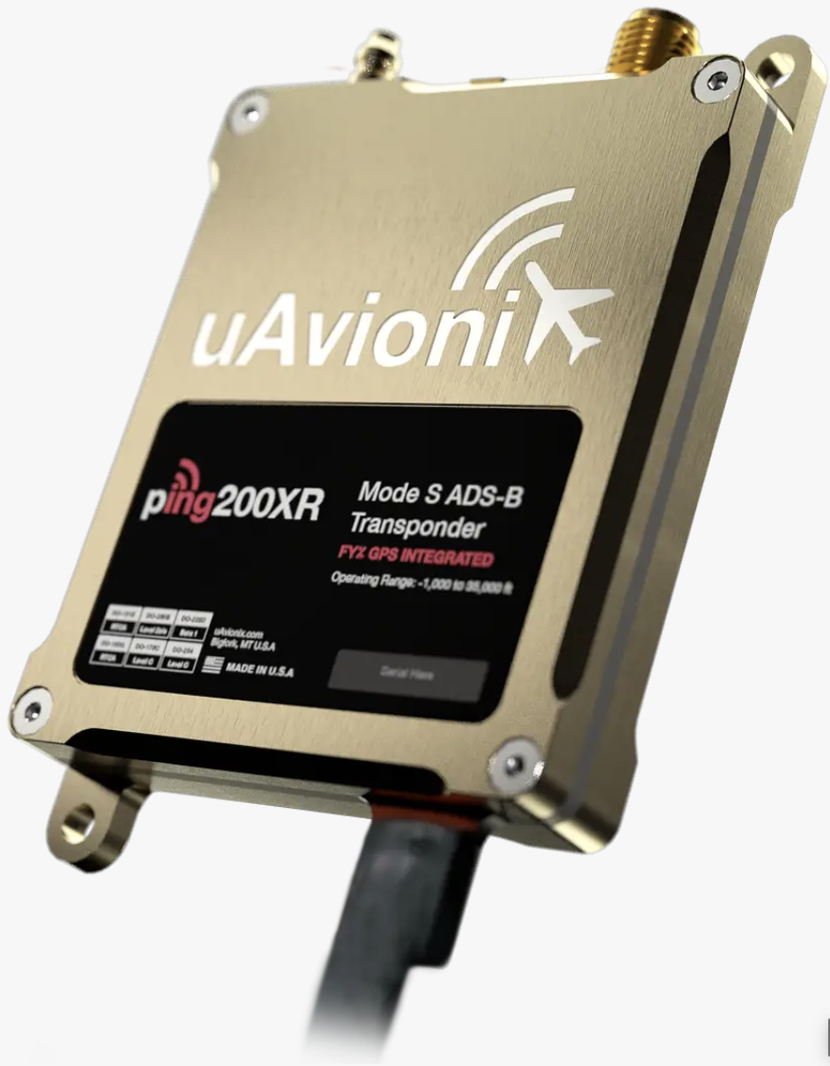
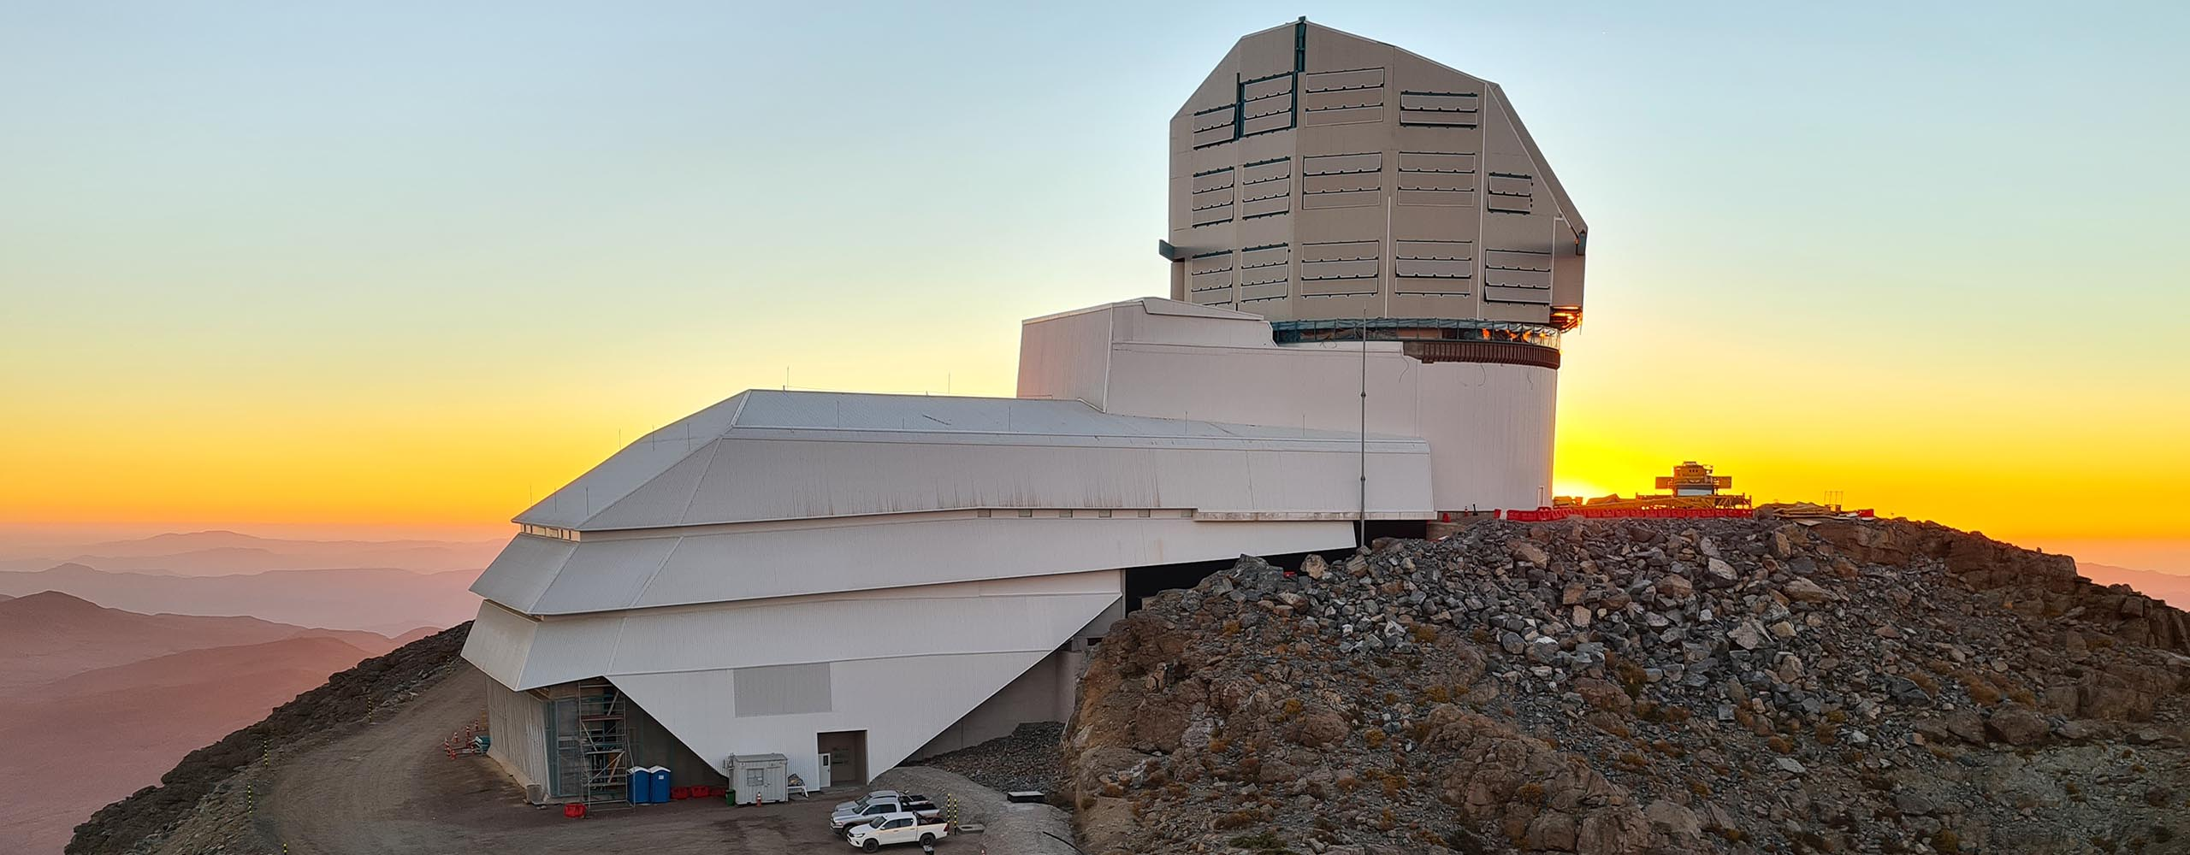



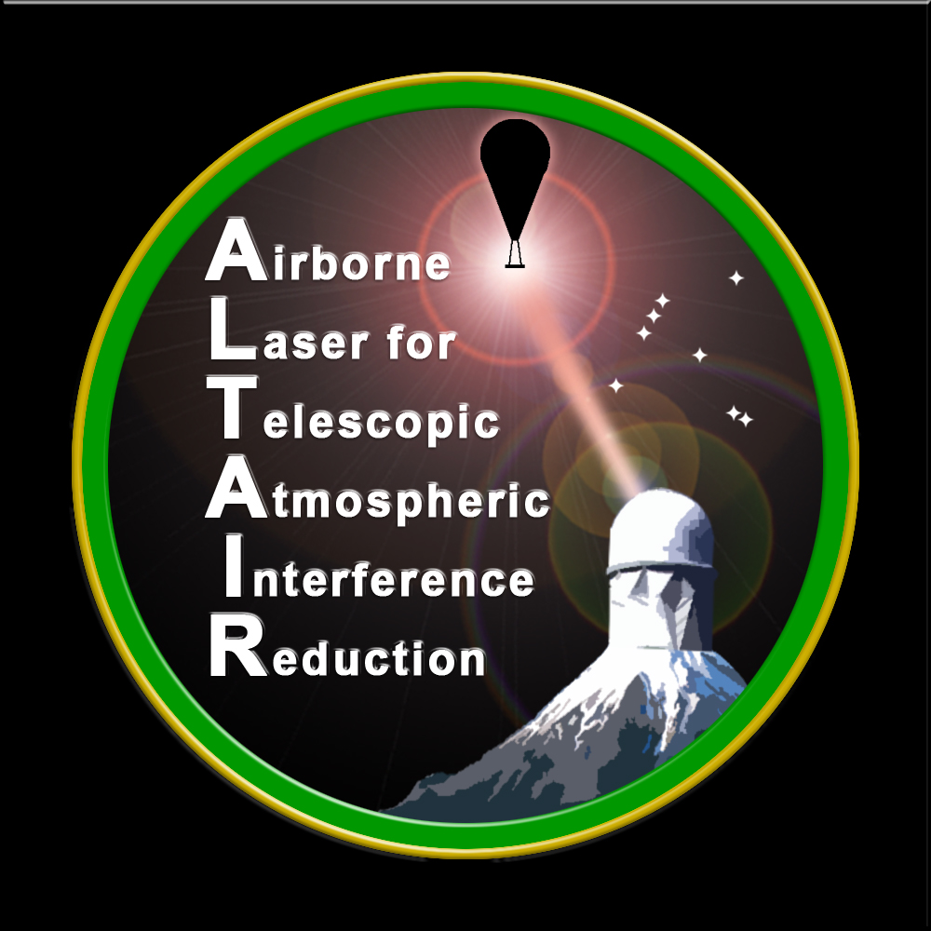

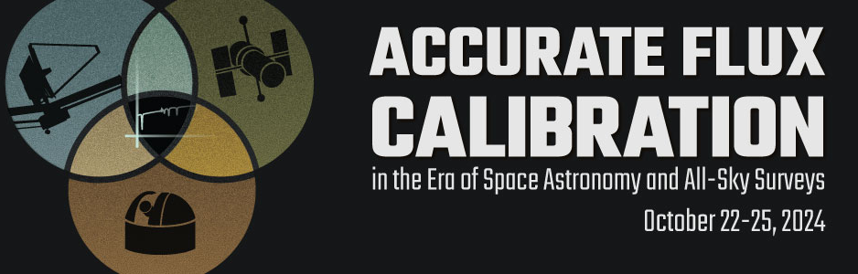
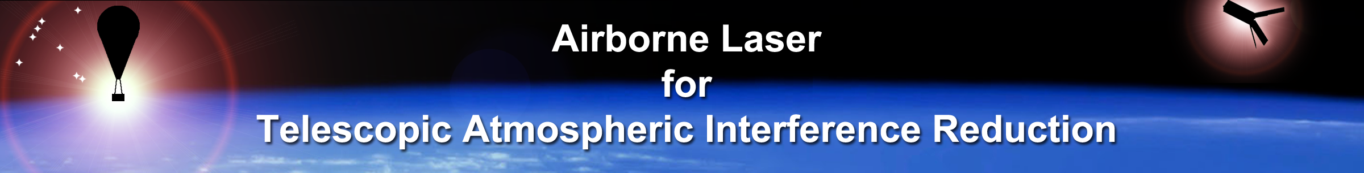
ALTAIR: High-Altitude, Low-Cost Micro-Airships for “Workhorse” Precision Rubin Observatory Calibration & Beyond
Justin Albert
University of Victoria
jalbert@uvic.ca

Slide 2
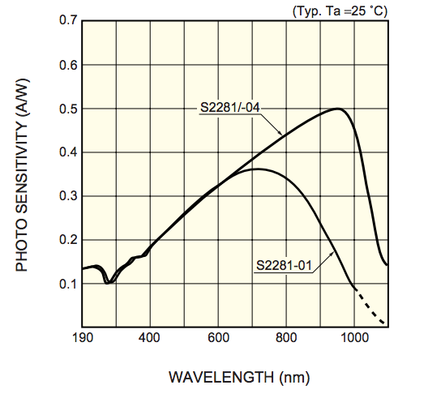
Basic Technique & Goal: A 0.1% Calibrated, Mobile Source Above the Atmosphere
Balloon Payload
Integrating
sphere
100 mW lasers
NIST-calibrated
photodiodes
440 nm
532 nm
658 nm
830 nm
Well-characterized
Lambertian spatial profile
Known
view angle
Telescope
NIST- & NRC-calibrated (~ 0.1% absolute)
photodiode spectral response
10/23/2024 ALTAIR J. Albert 2

Slide 3
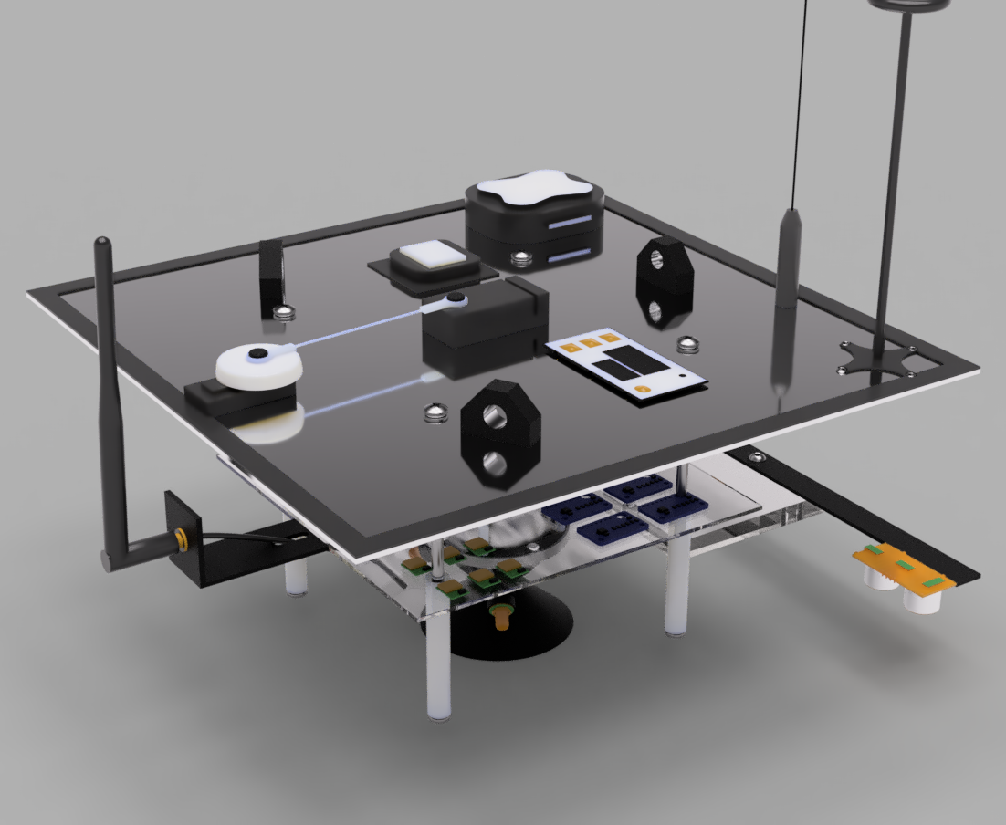
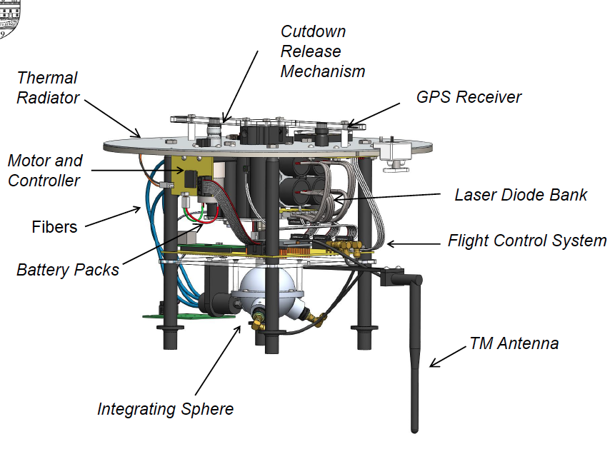

Basic Payload Design
10/23/2024 ALTAIR J. Albert 3

Slide 4
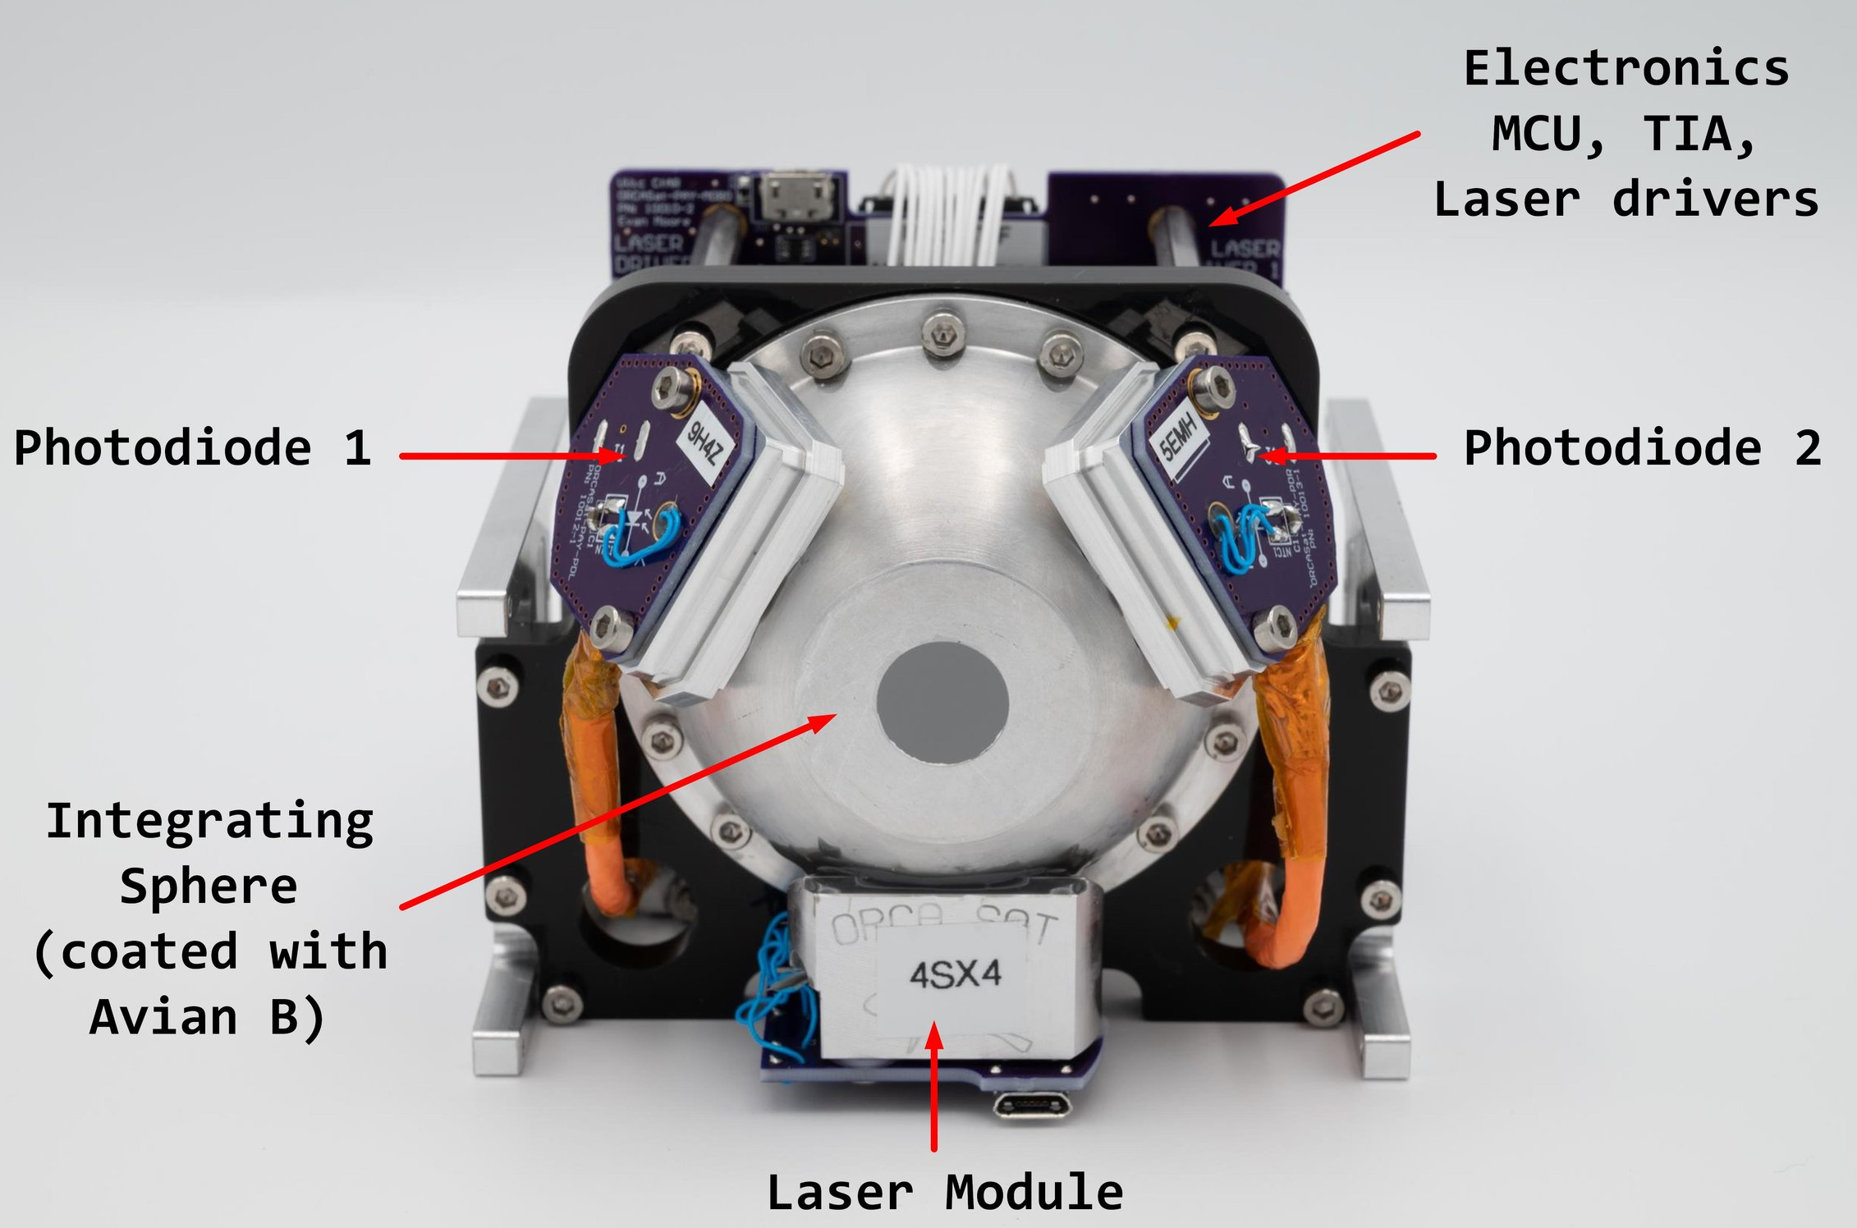
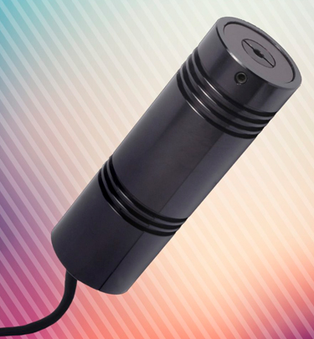
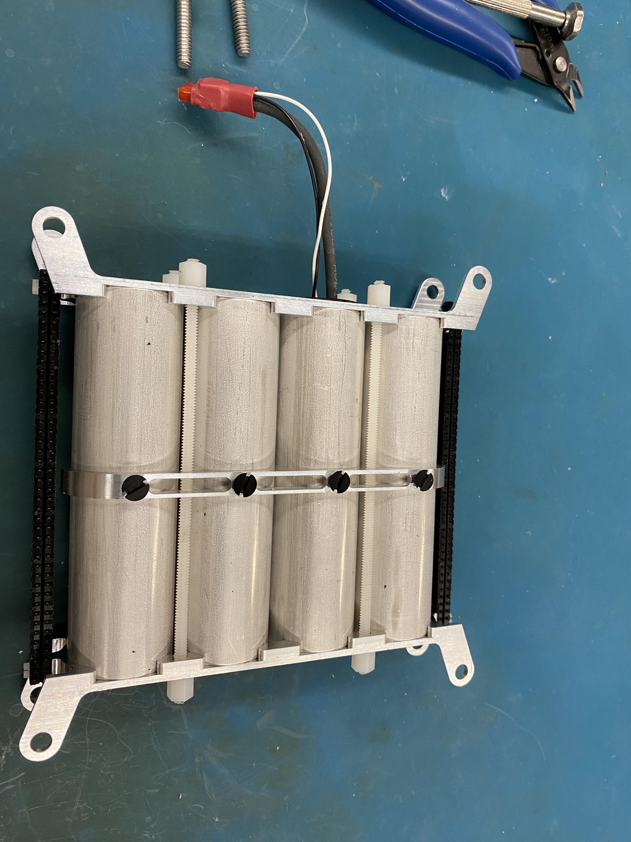
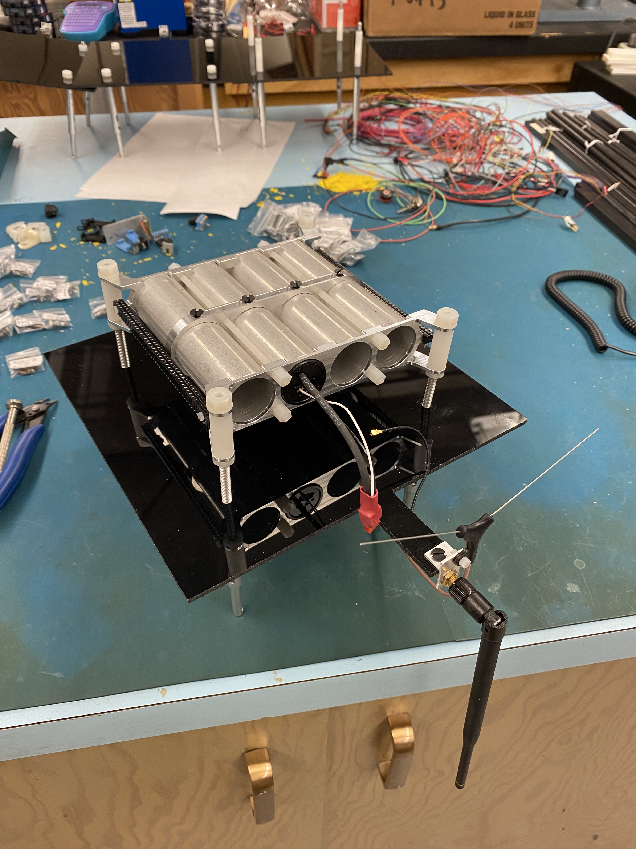
Light Sources & Calibrated Monitoring Photodiodes on 2” ID Integrating Sphere
Four WorldStarTech 100 mW laser diode modules, respectively 440 nm, 532 nm, 658 nm, & 830 nm, each fiber coupled into a fused-ends, “quadfurcated” MM optical fiber (custom fab’d by Ceramoptec).
Can be swapped out for 635 nm or 780 nm.
Can be swapped out for 808 nm or 850 nm.
One photodiode is a Hamamatsu S12698-01 (Si) and the other is a Hamamatsu G10899-03K (InGaAs).
(Utilizing two different photosensor material technologies is a useful cross-check.)
Can be swapped out for 405 nm.
Can be swapped out for 520 nm.
10/23/2024 ALTAIR J. Albert 4

Slide 5
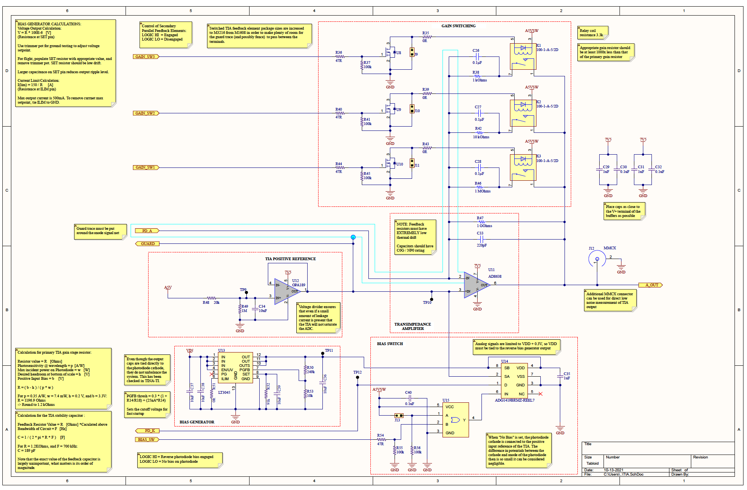
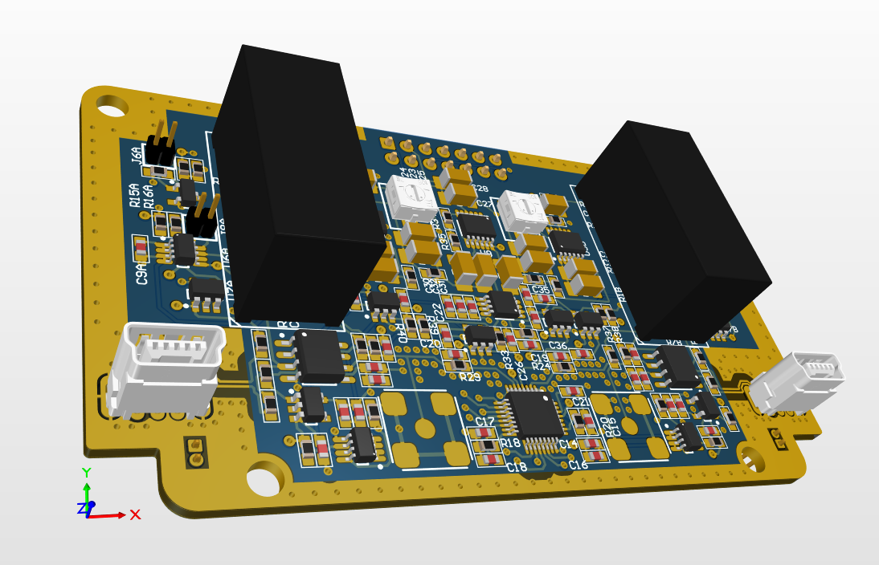
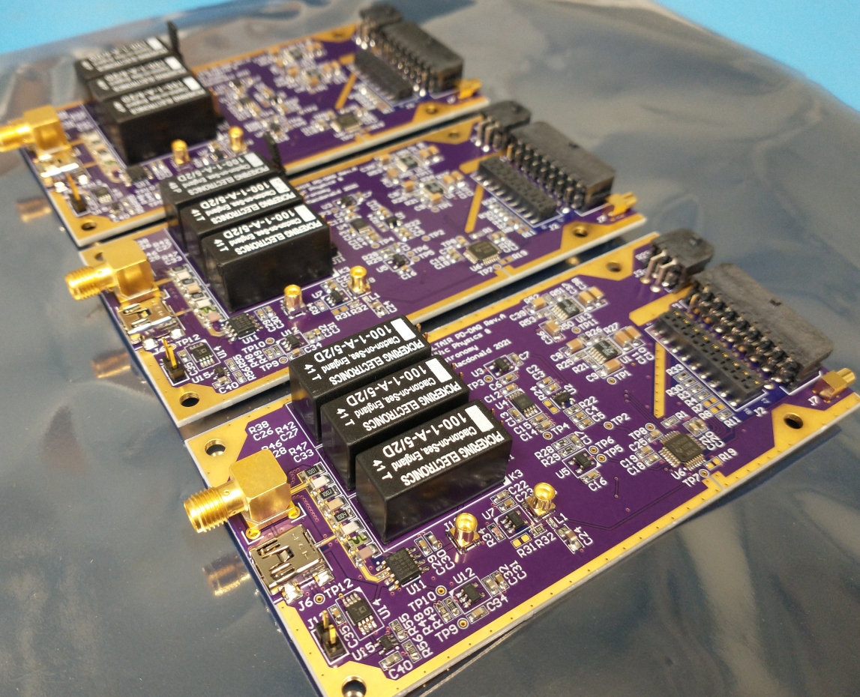
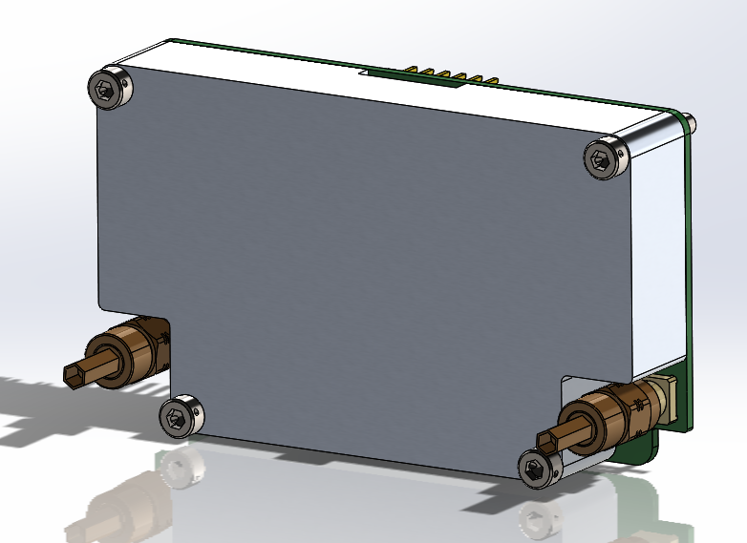
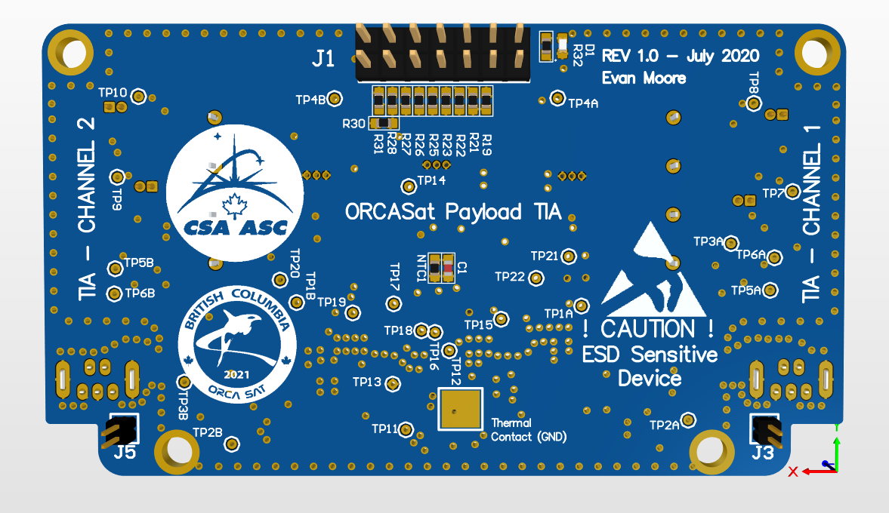
Photodiode readout and digitization
The precison heart of the mission…
10/23/2024 ALTAIR J. Albert 5

Slide 6
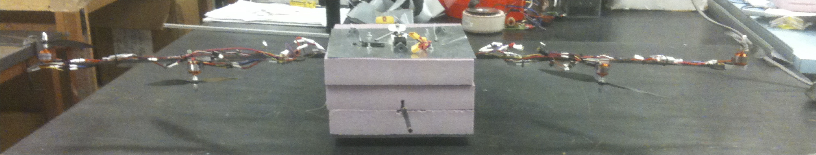
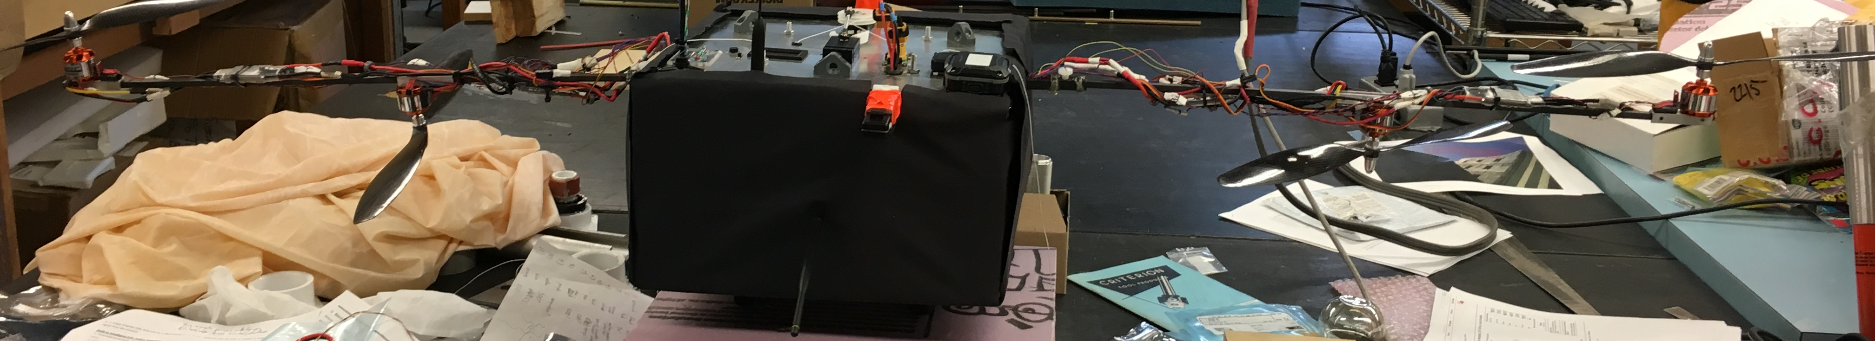
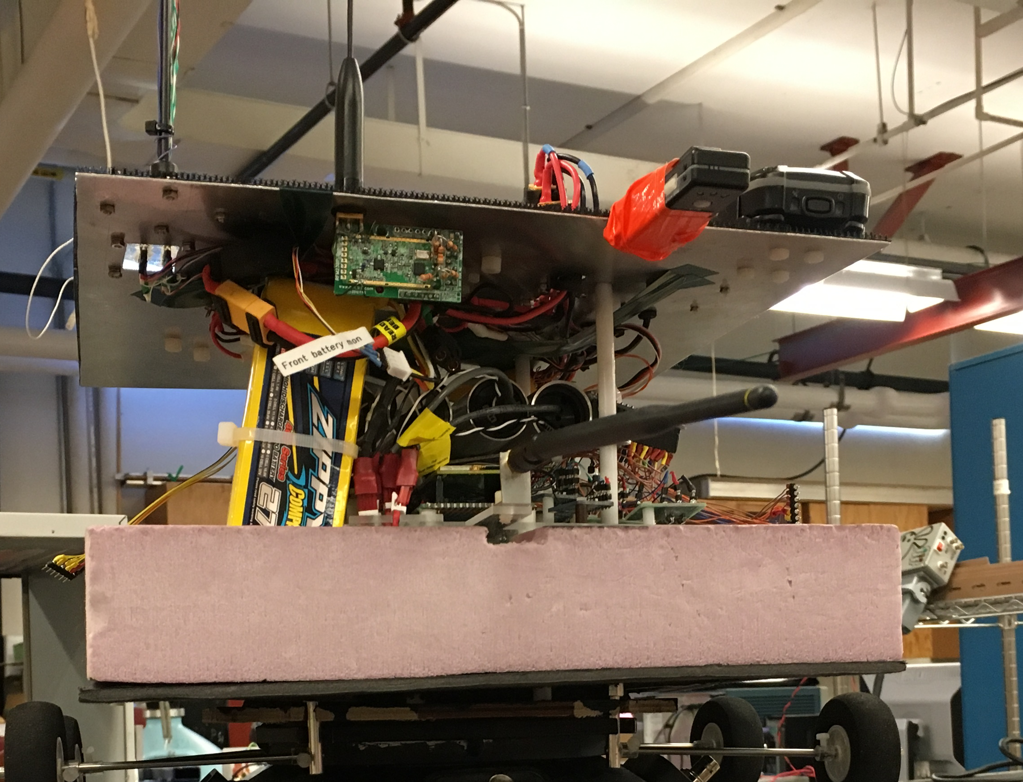
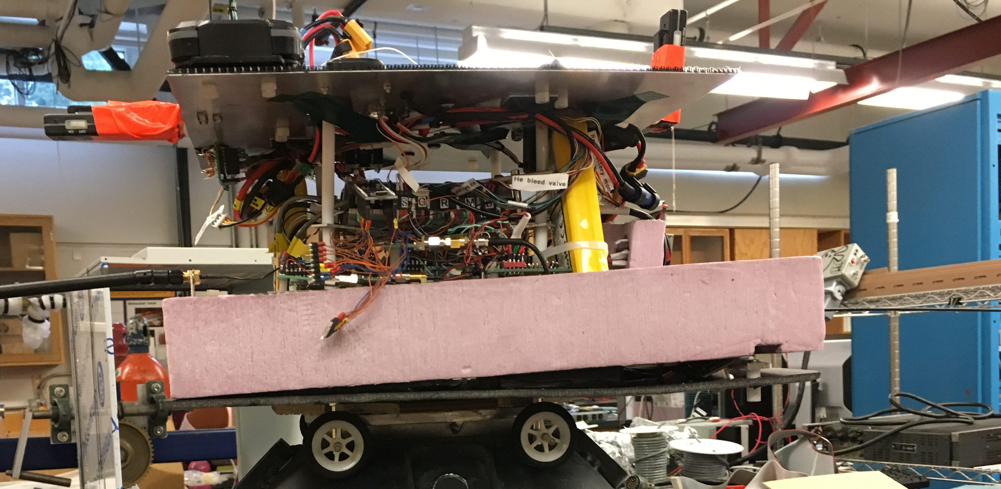
Payload
10/23/2024 ALTAIR J. Albert 6

Slide 7
Flight control – AIFCOMSS
Code actively maintained / updated at:
https://github.com/ProjectALTAIR/AIFCOMSSwithCUPredictorTest
ALTAIR Integrated Flight Control, Operation, Monitoring, & Simulation System
10/23/2024 ALTAIR J. Albert 7

Slide 8
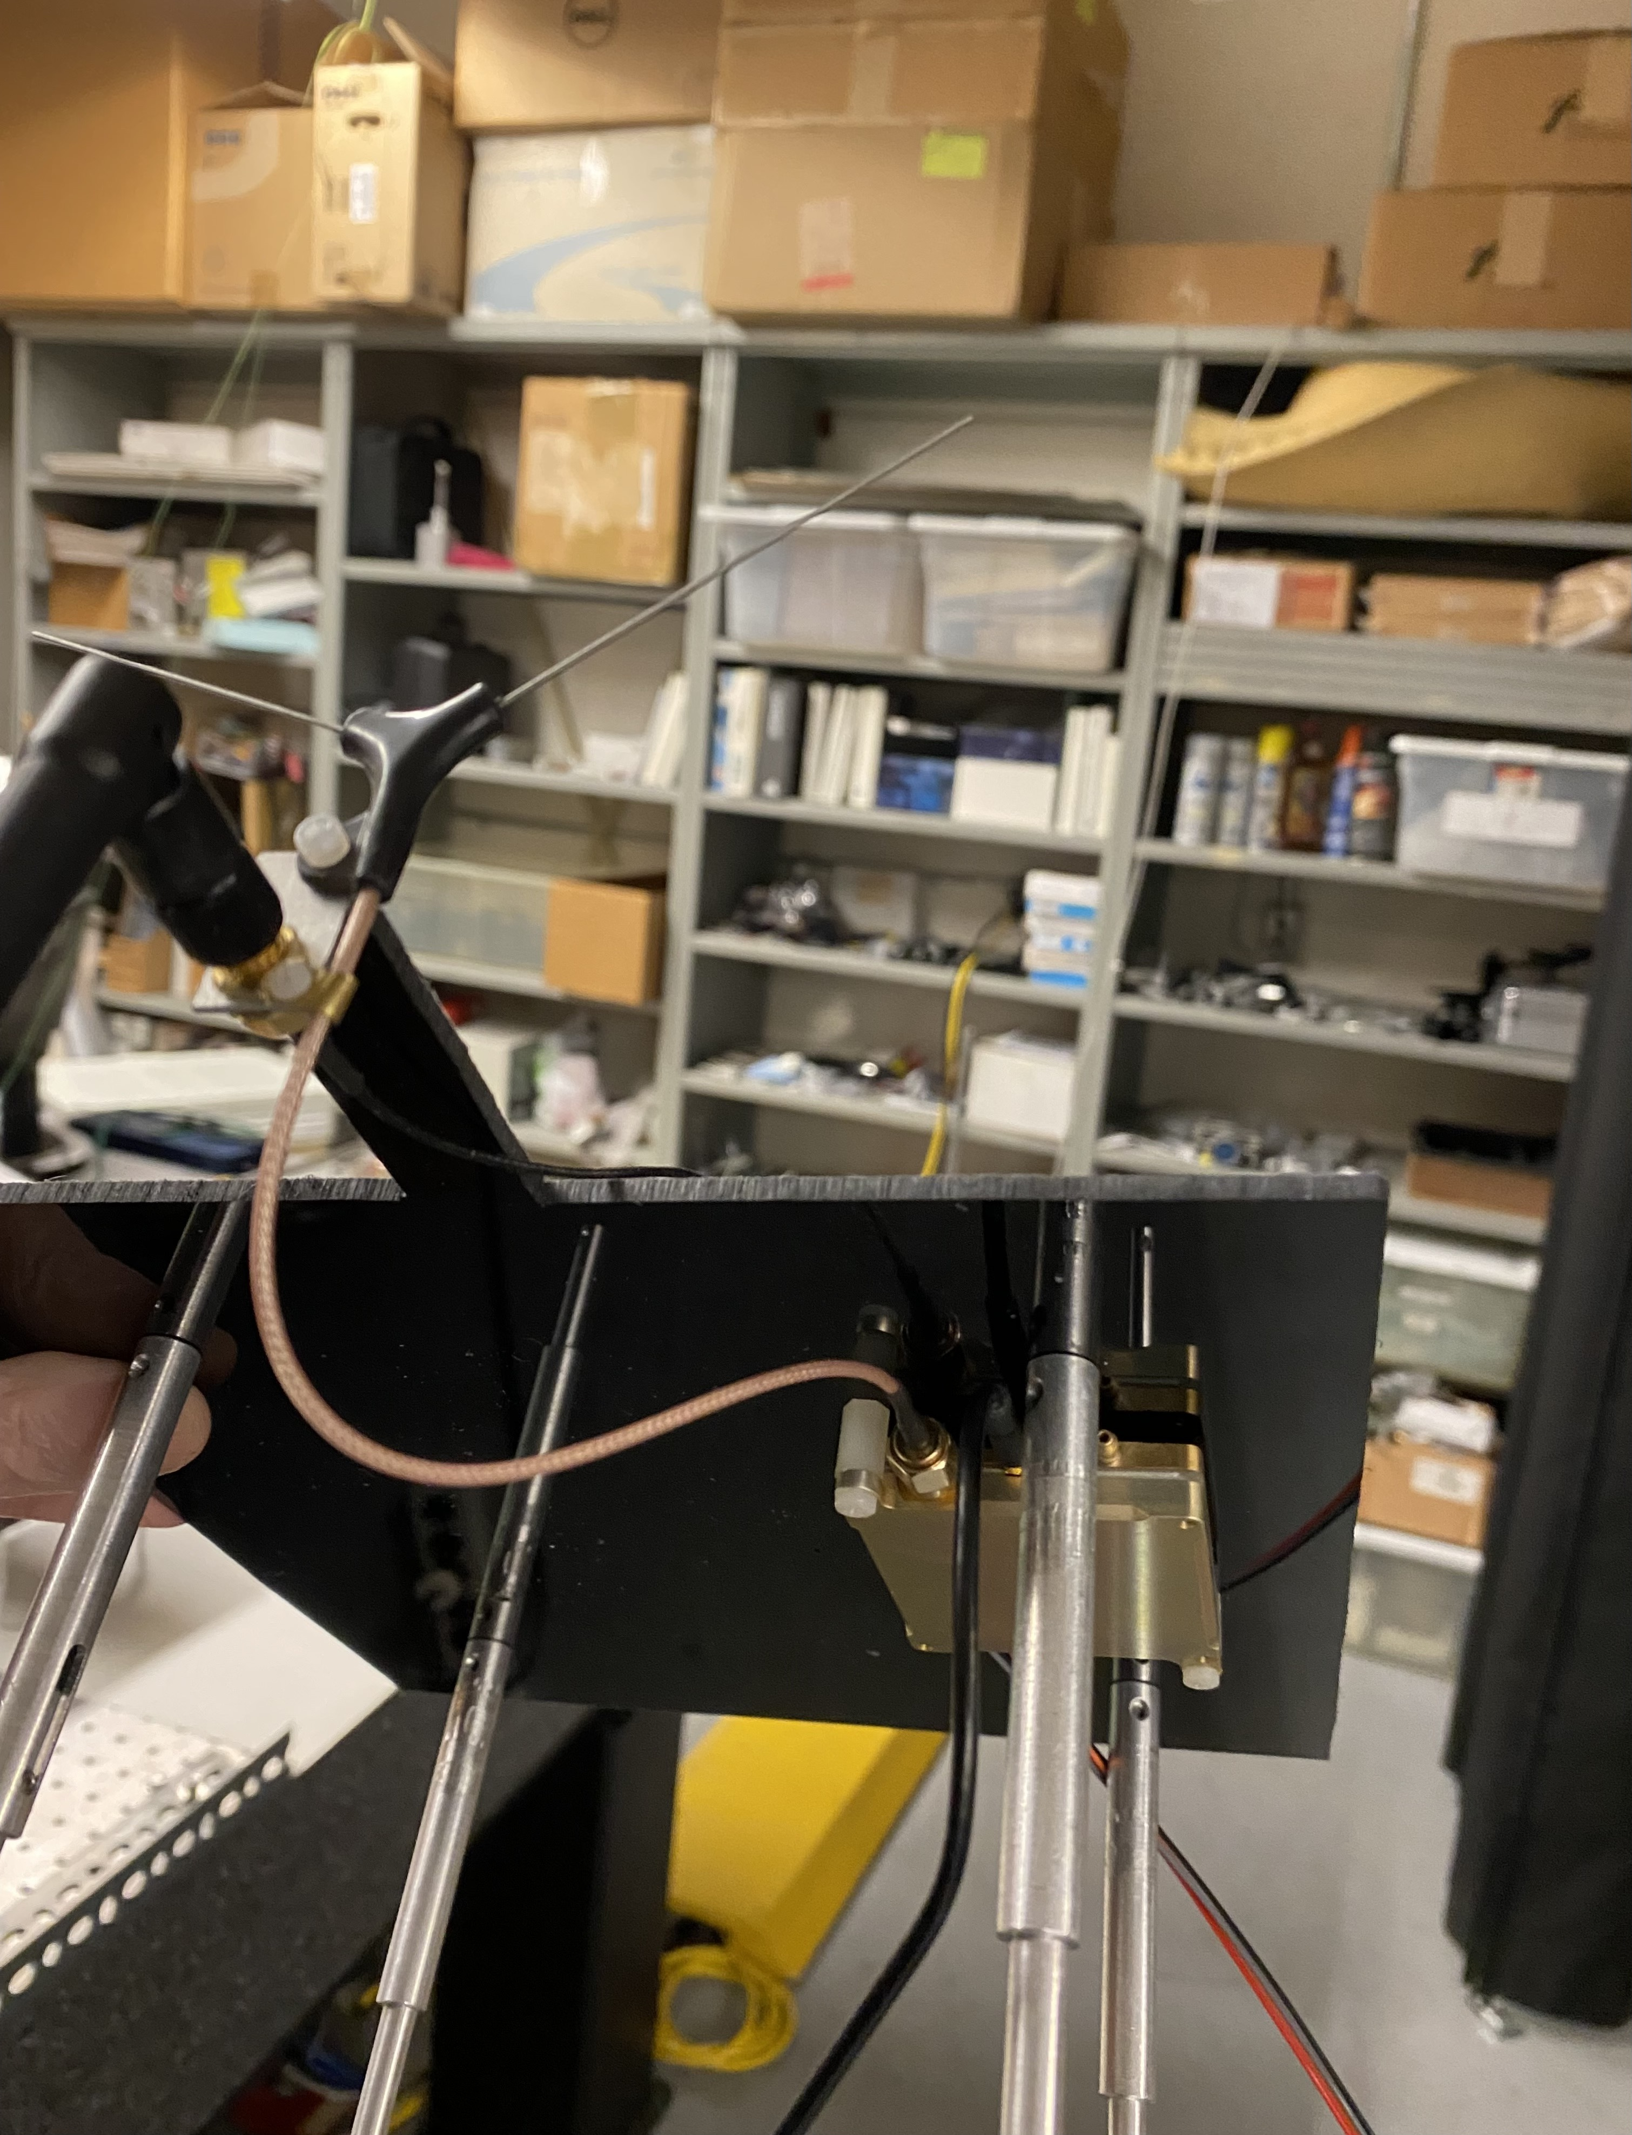
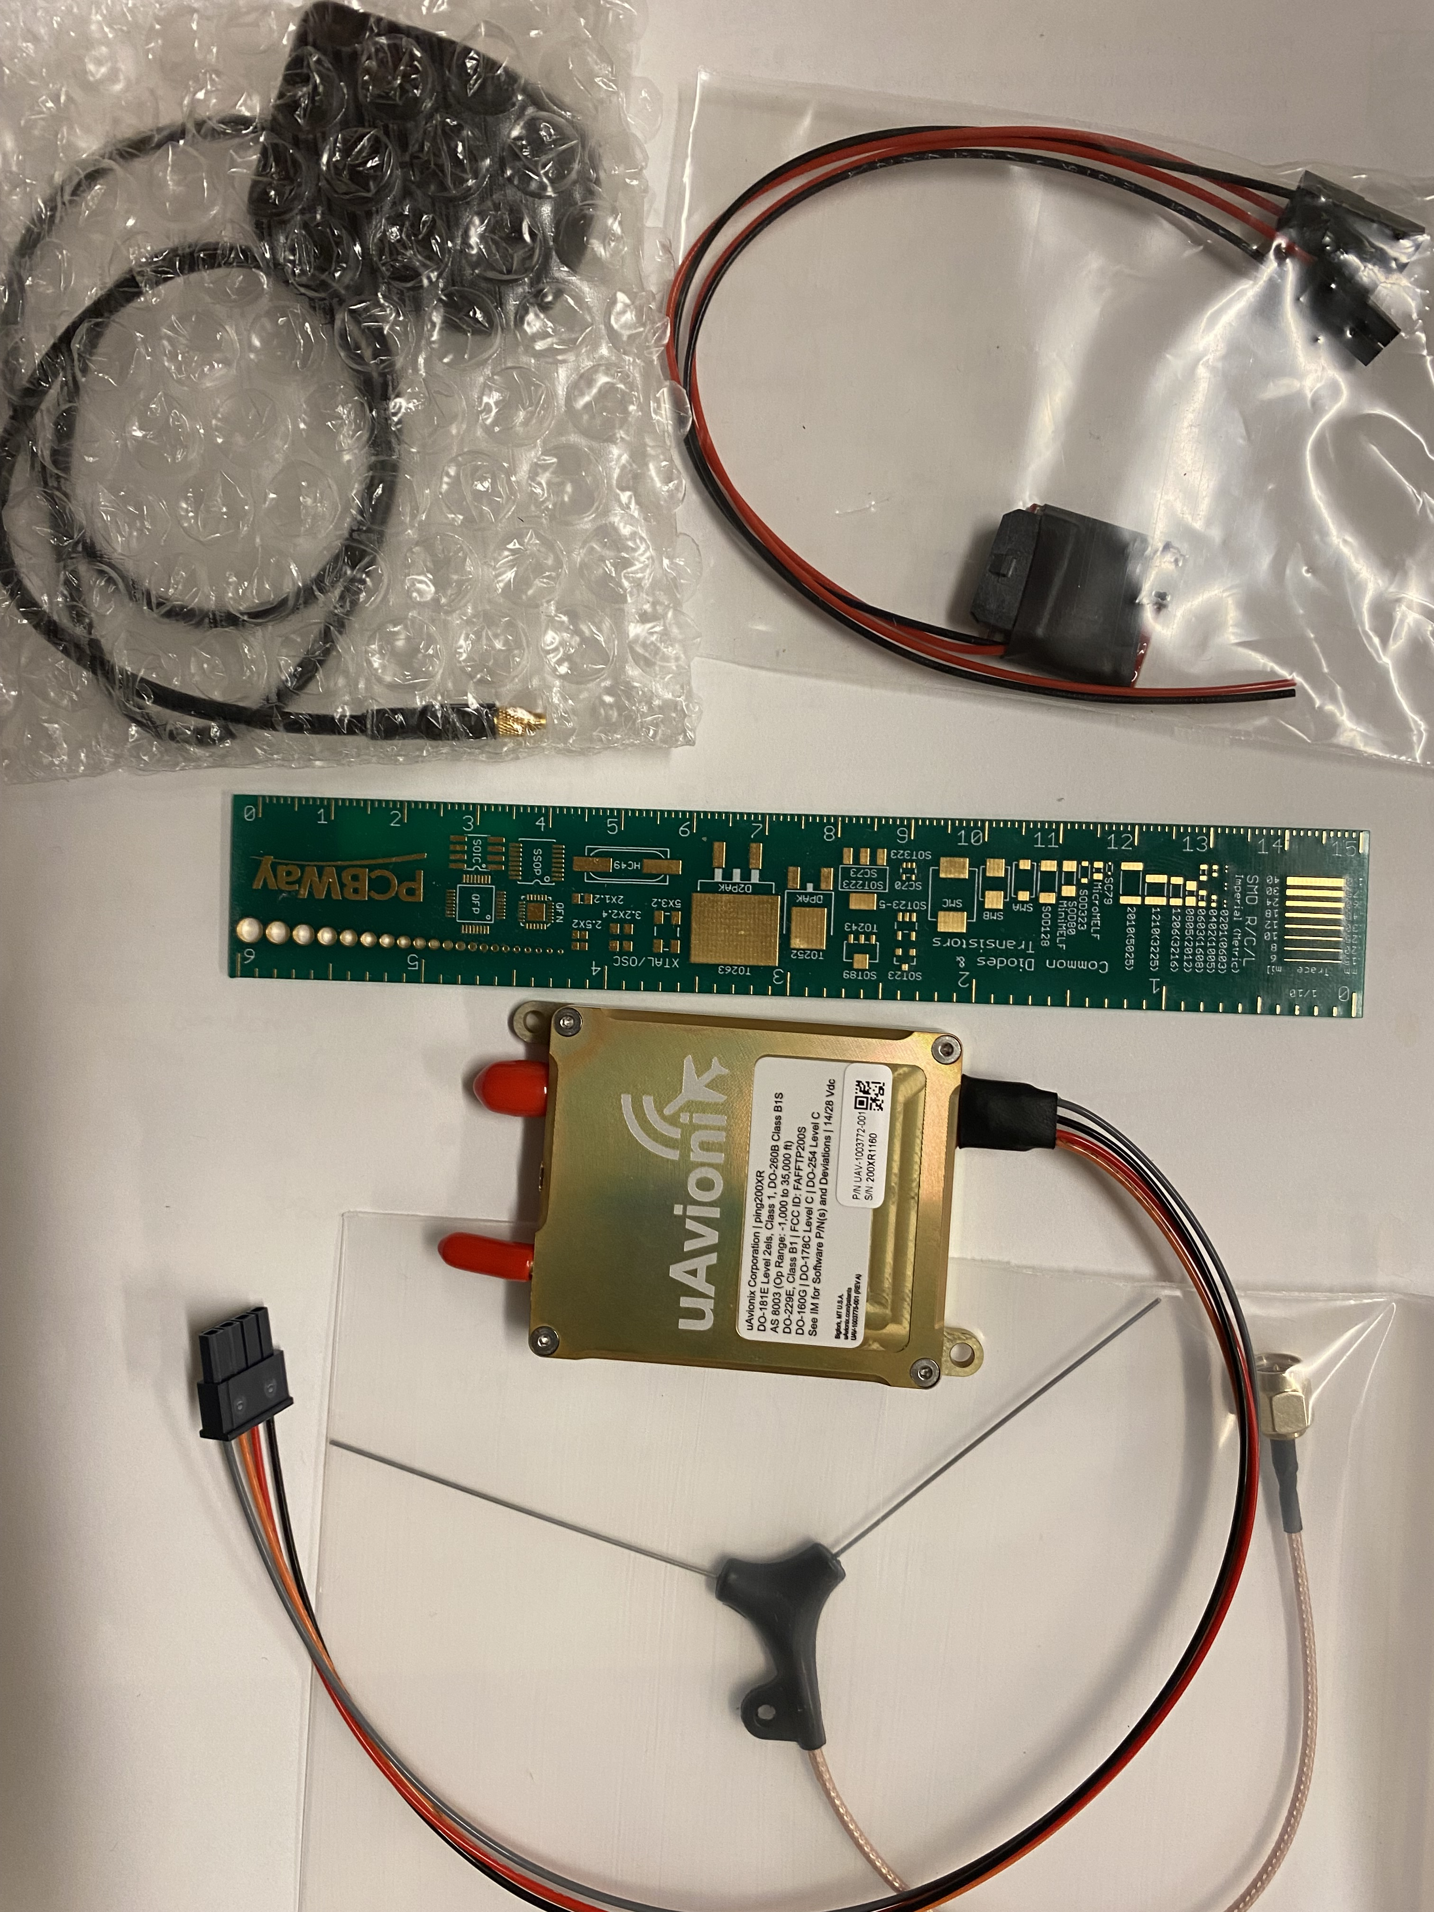
Onboard transponder (uAvionix ping900XR)
For continuous real-time communication with and identification to air traffic control.
(FAA & Transport Canada certified.)
So that we don’t get shot down by NORAD!!! ;)
(Or by the Chilean air force!!!)
10/23/2024 ALTAIR J. Albert 8

Slide 9
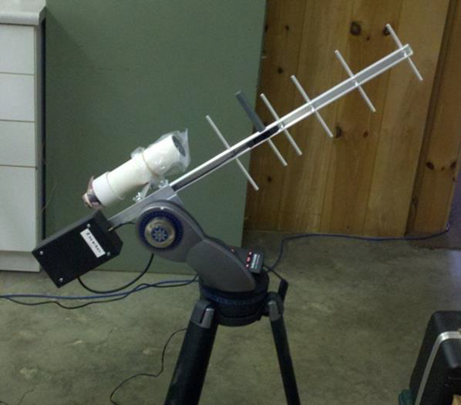
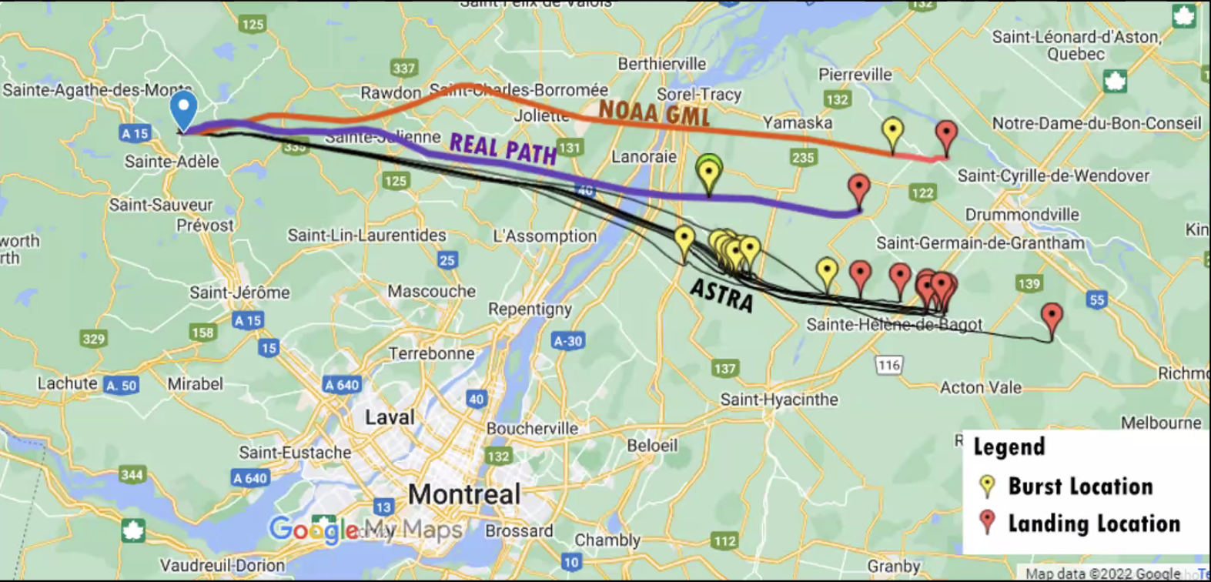
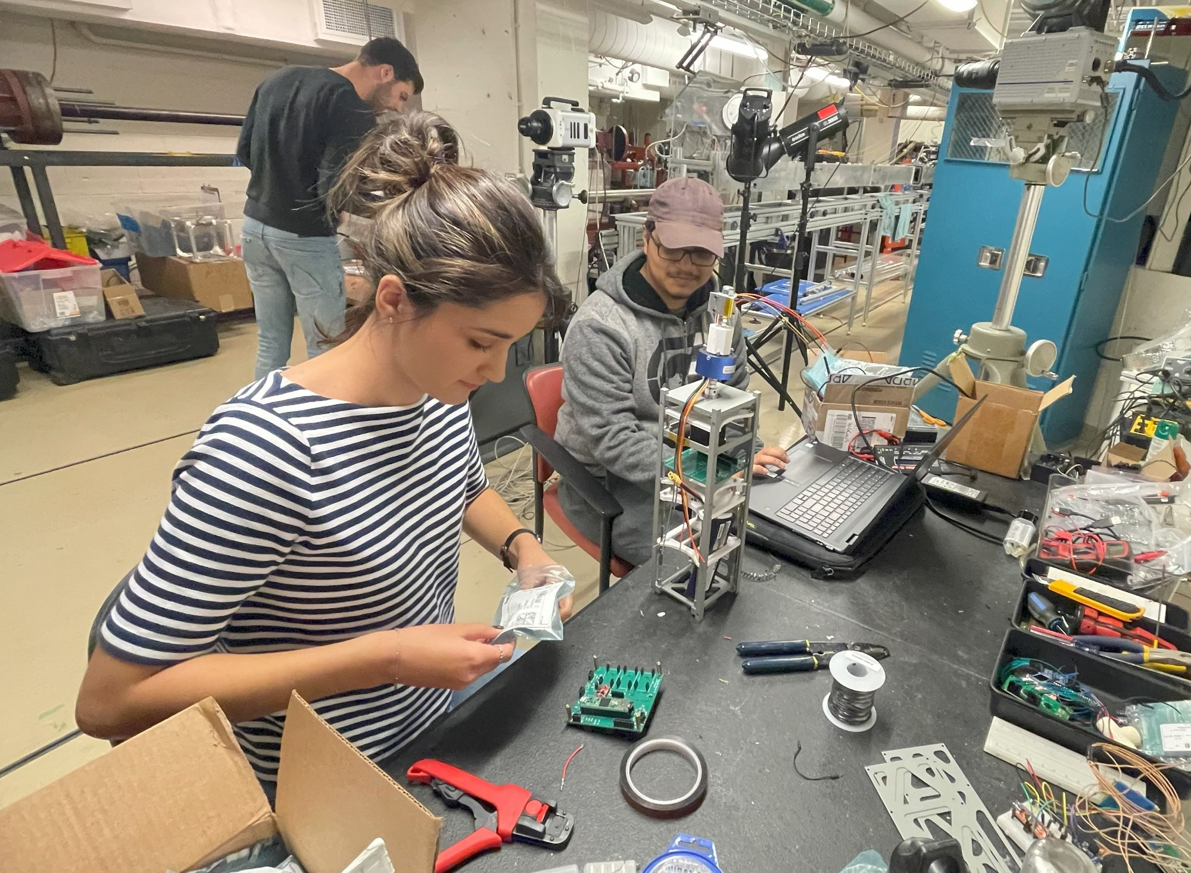
Operations & McGill / Montreal Test Flights
910 MHz portable directional ground antennas, range approx. 100 km.
Always ≥ 2 ground stations in contact.
10/23/2024 ALTAIR J. Albert 9

Slide 10
Conclusions
Artificial sources can in principle provide up to two orders of magnitude better photometric calibration precision than any stellar, non-solar light sources can presently.
  1) Can study them right in the lab before and after use, unlike stars.
  2) Can monitor them in-situ, in real time.
  3) Can also be used to calibrate white dwarfs (and other stars, and the Moon) very precisely, and on a detector-based standards scale.
  4) Small balloons are inexpensive!!!
  5) Fully observer-controlled choice of spectrum & color on demand, … and brightness, …exact location in the sky as function of time of night (or day), …
Not restricted to optical/IR!: e.g. a precisely-polarized Gunn diode-based precision microwave polarimetry calibration source could also be flown. (Radio, near-UV…)
Balloons, of course, do not replace additionally having a satellite source to (at
least occasionally!) determine effects from the very top of the atmosphere!!!
But ALTAIR-style balloons can (and I posit will!) be the low-cost, ground-
based-observatory-owned, workhorses.
E.g.: Rubin could own 3 or so!!! – launching them at dusk each night, flying to different areas of the sky, and having them return home at dawn each morning!
10/23/2024 ALTAIR J. Albert 10

Slide 11
Some separate & additional conclusions (backup slide)
A very interesting (& very useful) fact about Earth’s atmosphere is that, at mid-latitudes, winds in the upper troposphere statistically tend to be in opposite direction to winds in the lower stratosphere.
Thus, with just very small amounts of (weather-optimized) upward and downward propulsion (just above and below the tropopause), powered using very lightweight flexible solar panels on top of the balloon (+ onboard rechargeable LiPoly batteries for nighttime power), one could utilize the winds to circulate near the tropopause over a given region of Earth (e.g., over a region the size of Illinois, or of Vancouver Island, etc).
After a few weeks, a significant fraction of the helium would diffuse through the balloon latex, and the balloon would descend to base for (simple and low-cost!: latex balloons are about $150) balloon and helium replacement. Then, balloon and payload would be sent back up again.
This opens up many additional, very different usage possibilities:
  Communication: replacing the need for cell-phone towers with very wide coverage balloons in remote (or not-so-remote) areas.
  Earth observation (for, e.g., long-term studies of Arctic ice, etc.)
  …… !
10/23/2024 ALTAIR J. Albert B1

