Slide 1
VISPA Research Centre
Victoria Subatomic Physics and Accelerator Research Centre
Randall Sobie, Director
February 2025
VISPA was established in 2011 as a University Research Centre
https://www.uvic.ca/science/physics/vispa/index.php
Our 80 members are engaged in particle physics experiments, accelerator physics and
theoretical challenges to understand the fundamental nature of the universe
Last meeting in March 2023
https://particle.phys.uvic.ca/~rsobie/VISPA-March2023-Final.pdf
These slides will focus on recent activities

Slide 2
Research in VISPA
Global endeavours requiring some of the largest facilities in the world
Experiments (spanning decades) involving 1000s researchers
Accelerator facilities spanning kilometers or across continents
Complex and large particle detectors
Long term projects with 10-20 year horizons
Future accelerator research and development
CFI Application for the Canadian Contribution to the Electron-Ion Collider (Brookhaven NL)
Theoretical studies
Particle astrophysics
Computing and networks managing exabyte-scale data
Belle II detector at KEK Japan
27km tunnel at the Large Hadron Collider

Slide 3
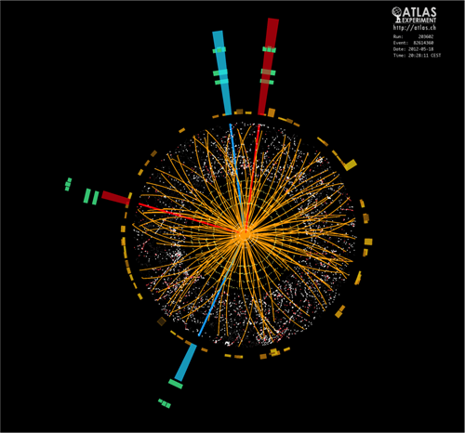
Outlook for the coming years
Exciting period of science with discovery potential
ATLAS data taking with higher luminosity collider
Higgs and energy frontier physics
Belle II at KEK accumulating large samples of electron-positron collision data Probing fundamental symmetries such as time reversal
Construction of HyperK detector at KEK, Japan
Exploring neutrino properties
New projects
Mathusla CERN
P-One neutrino observatory
Enabling applied research
Accelerator physics
Detectors and radioisotopes in medicine
Cloud computing, networks and data management

Slide 4
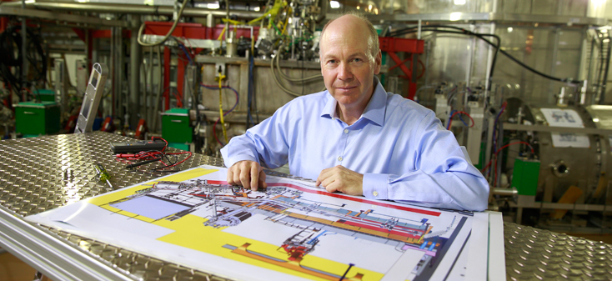
Members of VISPA
Members
11 faculty, 2 IPP Research Scientists, 15 Adjunct faculty
8 post-docs, 6 staff, 36 graduate students and undergraduate students
Two new CRC Chairs and one new faculty member in 2024-2025
Heather Russell (CRC), Dominque Trischuk (CRC)
Research areas and projects
Accelerator Physics, ATLAS (CERN), ARIEL (TRIUMF), BaBar (SLAC/USA), Belle II (KEK/Japan)
T2K/HyperK (KEK/Japan), MATHUSLA, Theory, Computing, Dark Energy
Leadership roles in projects and organizations
R McPherson Spokesperson and PI of ATLAS Canada
R Sobie Chair Researcher Council, Digital Research Alliance of Canada
M Lefebvre TRIUMF Science Council
M Roney Chair Belle II Executive Board, Scientific leader of BaBar experiment
Dean Karlen
CERN Visit May 2023:
President Kevin Hall, Heather Russell

Slide 5
Noteworthy items I
Accelerator physics
Growing number of graduate students (14) located at UVic and TRIUMF
Increasing engagement with industry
Detector development hub for the MacDonald Institute
Resources/funds to help support particle-astrophysics and neutrino experiments 2025
P-One (ONC neutrino experiment)
Ongoing CFI-funded projects
HyperK neutrino experiment detector construction I and II (2 awards)
ATLAS Detector Upgrades I and II (2 awards)
ARIEL
Belle II Computing Centre
Detector/computing R&D, JELF funds
CFI application (submitted) for the Belle II experiment
Accelerator upgrade for the polarization of the electron beam (enabling new physics capabilities)

Slide 6
Noteworthy items II
Detector fabrication and development in the VISPA detector laboratory
Construction of the HyperK photomultiplier systems beginning in mid-2025 (CFI funded)
ATLAS FPGA development for the upcoming upgrades of the experiment
Pending NSERC Subatomic Physics MRS application for personnel support
Global engagement and international visibility
Strong international links to CERN (Switzerland), KEK (Japan), ..
National links
CANARIE
Digital Research Alliance of Canada
TRIUMF, SNOLAB, MacDonald Institute, Perimeter Institute

Slide 7
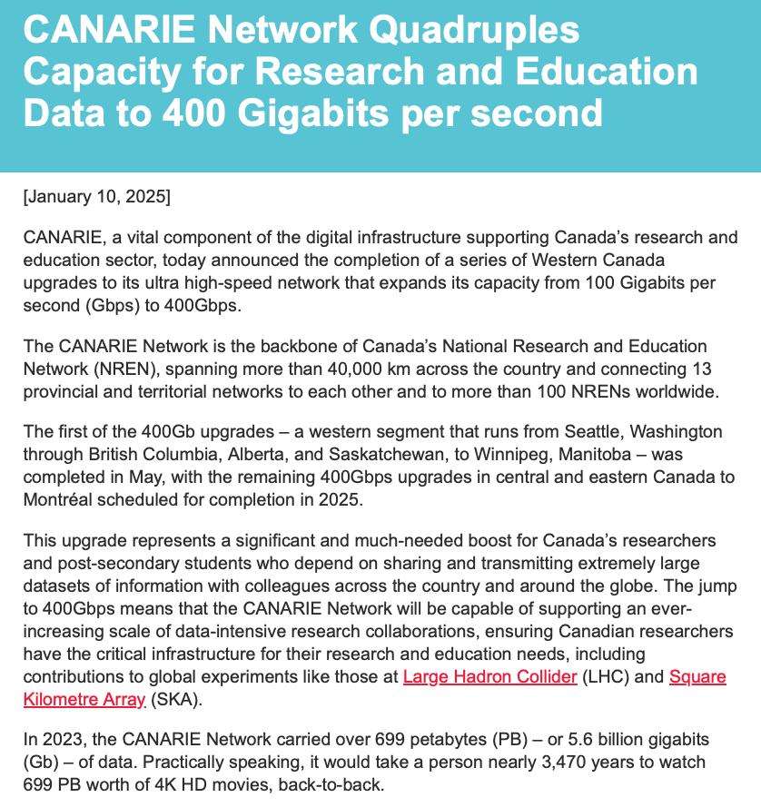
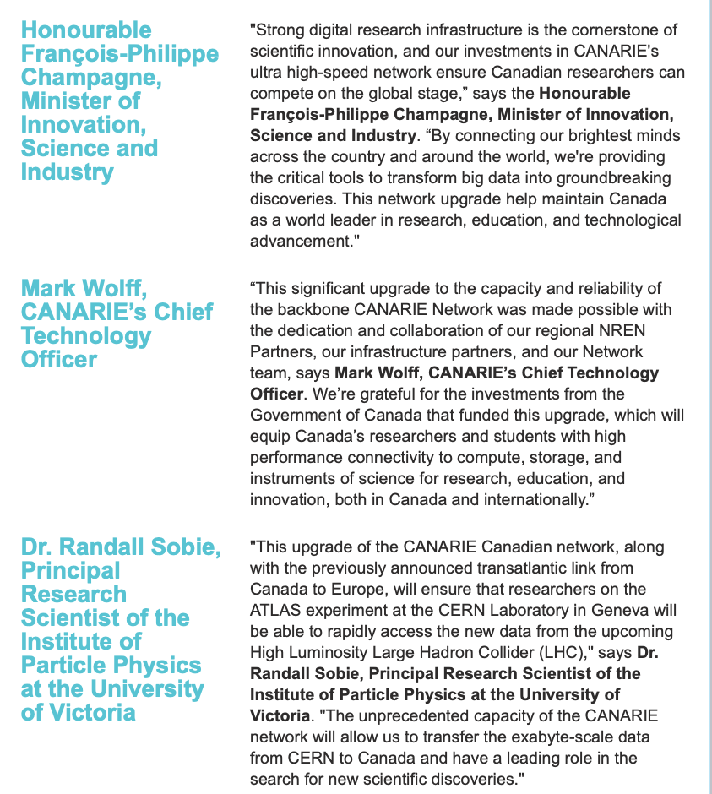
Research Computing
Digital Research Infrastructure (DRI)
Critical element of particle physics research
ATLAS expects to have 10 exabytes of data by 2030
Research networks in Canada and international links
Home to HEPNET/Canada: responsible for national/international networks for HEP
2025 CANARIE new release on 400G network
Hosted international HEP network meeting in 2023
Key role in Digital Research Alliance of Canada
Refresh of the UVic Arbutus cloud in 2025
Strong ties to Research computing team in UVic Systems Group
Collaboration in data management with UVic Library
Active in Alliance commercial cloud pilot program

Slide 8
Summary
VISPA is recognized as a key research centre on campus
Applied research in accelerators, radiation detectors, covid-modeling, cloud computing, research networks
Strong track record of success with CFI
Its members are leaders in particle physics experiments and theory
Strong record of funding, leading number of citations and impact in science output
Expanding connections with TRIUMF
Accelerator, theoretical and experimental physics
Profile of the centre and its members
Public lectures, outreach, communications, laboratory-visits
Training of HQP
HQP are highly skilled in a competitive international environment
Employed in wide range of research, health and industrial areas

Slide 9
VISPA Faculty Members
Faculty
Institute of Particle Physics Research Scientists
TRIUMF Research Scientists

Slide 10
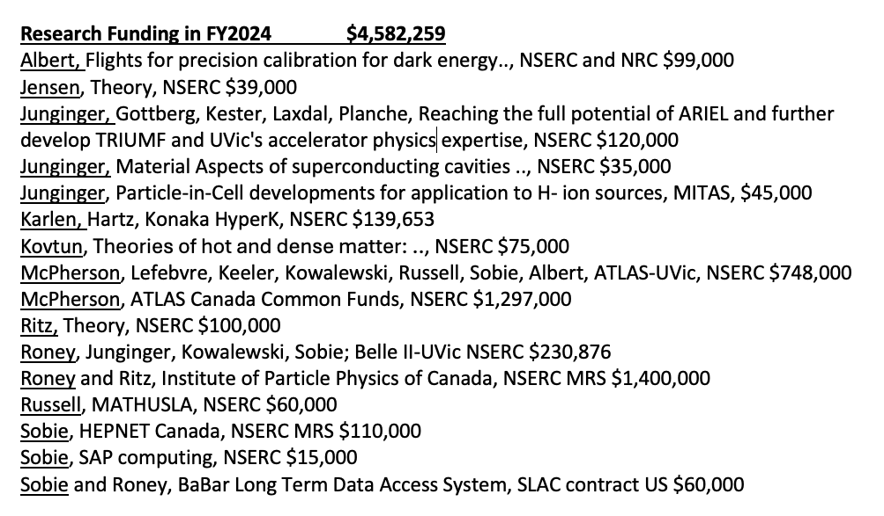
VISPA research funding

Slide 11
Highly qualified personnel
Undergraduate research students
Key area with students from physics, computer science and engineering
Graduate students
42 graduate students in 2023 (103 in the Department)
Research associates and post-doctoral fellow
International impact at the labs
Research staff
Detector development and construction; computing
UVic graduate student in ATLAS control room
Alumni include leading faculty and scientists (TRIUMF, SNOLAB, CERN, McGill, Carleton, York, Manitoba, ..)
Medical physics and particle detector development
Financial and investment banking, novel technologies
Cloud computing and network industry

Slide 12
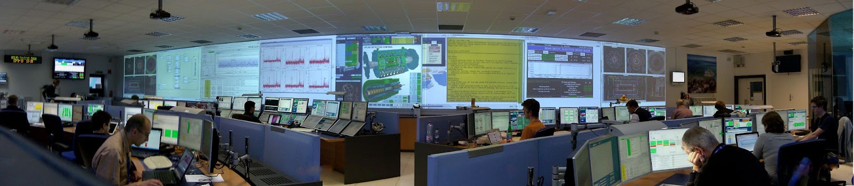
Research Impact –
500+ papers and 35000+ citations in the past 5 years
NSERC and other grants
FY2024 $4,582,000 (not including recent supplements)
FY2023 $3,343,000
FY2022 $2,984,000
FY2021 $3,056,000
FY2020 $2,980,000
FY2019 $2,702,000
FY2018 $2,534,000
CFI awards
Karlen et al HyperK experiment
Karlen et al Superconducting electron accelerator at TRIUMF
Karlen et al ARIEL II
McPherson et al ATLAS Upgrades I
McPherson et al ATLAS Upgrades II
Sobie et al Belle II Raw Data Centre
Sobie et al Distributed cloud computing and data storage
Sobie et al Research computing and storage centre

